Slide 1
Reinforcement learning theory
Lei Ying

Slide 2
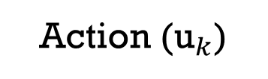
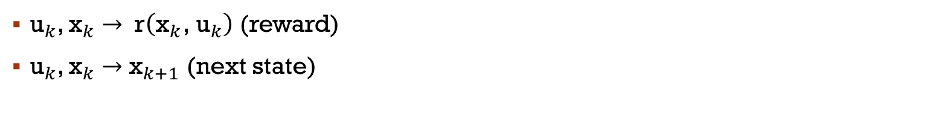
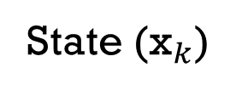
Reinforcement learning
Agent (Controller)
Learning from Interaction
Action (${\text{u}}_{k}$)
State (${\text{x}}_{k}$)
Environment
(Dynamical System )
${\text{u}}_{k}$, ${\text{x}}_{k}$ $→$ $\text{r}\left({\text{x}}_{k}\text{, }{\text{u}}_{k}\right)$ (reward)
${\text{u}}_{k}$, ${\text{x}}_{k}$ $→$ ${\text{x}}_{k+1}$ (next state)

Slide 3
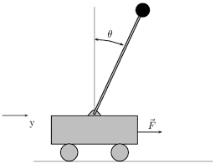
Example: cart-pole
Objective: Balance a pole on top of a movable cart
State: angle, position, horizontal velocity, …
Action: horizontal force
Reward: unit reward at each time step when the pole is upright

Slide 4
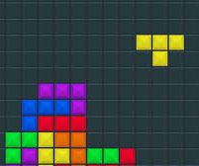
Example: Tetris
Objective: stay in the game as long as possible
State: the state of the tiles
Action: orientation of the falling piece
Reward: unit reward at each time staying in the game

Slide 5
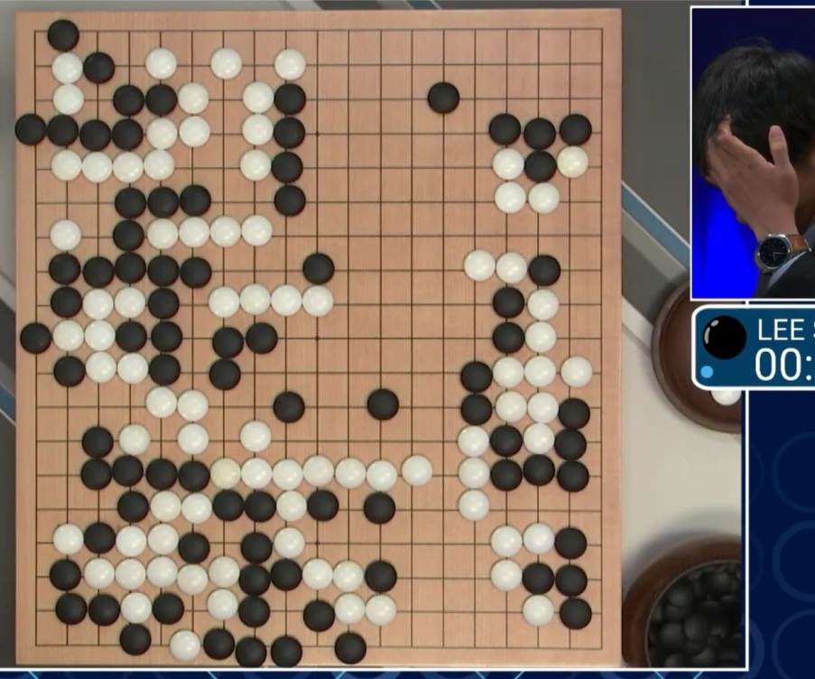
Example: Go
Objective: win the game
State: position of all pieces
Action: location of the next piece
Reward: 1 when winning the game and 0 otherwise

Slide 6
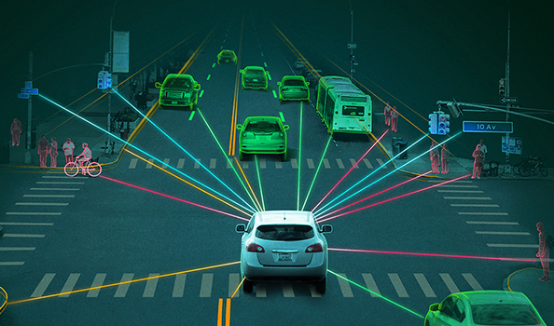
Example: self-driving
Objective: safe and efficient transportation
State: position of the car and the surrounding environment
Action: steering, brakes, accelerates
Reward: reward when keeping in the lane, avoid accident

Slide 7
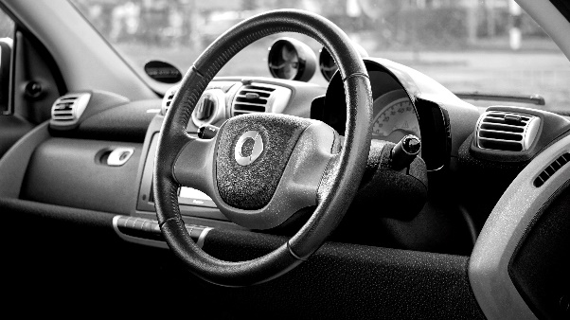
Reinforcement learning
Agent
Important Features
Discover optimal actions by trying them (trial-and-error search)
Current action affects next state
Maximize long-term return instead of instantaneous rewards
Action
State
Environment

Slide 8
Reinforcement learning
Difference from supervised learning
no access to labelled data (state, correct action)
RL: learning from its own experience (have to explore)
Difference from unsupervised learning
Unsupervised learning: finding hidden structure (e.g. clustering using PCA or K-means)
RL: maximizing the long-term return.
RL: Data-driven decision/control engines (instead of knowledge engines)
Agent
Action
State
Environment

Slide 9

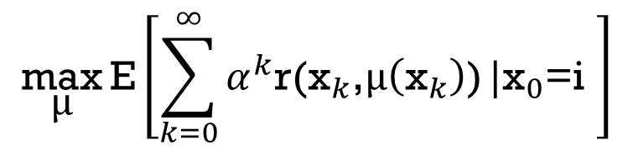
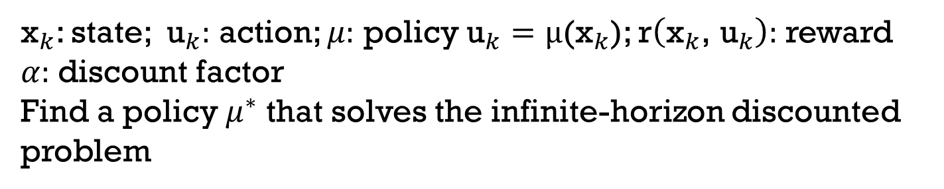

Reinforcement learning and dynamic programming
${\text{x}}_{k}$: state; ${\text{u}}_{k}:$ action; $μ:$ policy ${\text{u}}_{k}=\text{μ}\text{(}{\text{x}}_{k}\text{)}$; $\text{r}\left({\text{x}}_{k}\text{, }{\text{u}}_{k}\right):$ reward
$α:$discount factor
Find a policy $μ^{∗}$ that solves the infinite-horizon discounted problem
Agent
$$\underset{\text{μ}}{\text{max}}{\text{E}\left[\sum_{k=0}^{∞}{α^{k}\text{r}\text{(}{\text{x}}_{k}\text{,}\text{μ}\left({\text{x}}_{k}\right)\text{)}}|{\text{x}}_{0}\text{=}\text{i} \right]}$$
Action
State
stage T+2
stage T+1
current stage
(stage T)
0.5
infinite horizon
u
0.5
$$\text{v}$$
1
Environment
Need to know the total future reward!

Slide 10
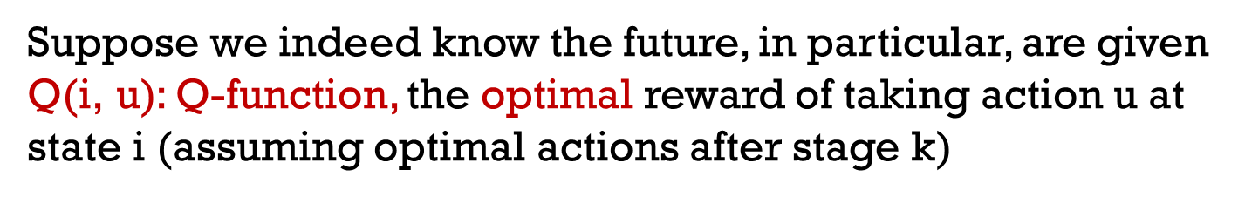


Reinforcement learning and dynamic programming
Suppose we indeed know the future, in particular, are given
$\text{Q}\text{(}\text{i}\text{, }\text{u}\text{)}$: Q-function, the optimal reward of taking action u at state i (assuming optimal actions after stage k)
Agent
Action
State
$$\text{Q}\text{(}\text{i}\text{, }\text{u}\text{)}\text{ > ?<}\text{Q}\text{(}\text{i}\text{, }\text{v}\text{)}$$
0.5
infinite horizon
u
0.5
$$\text{v}$$
1
Environment

Slide 11


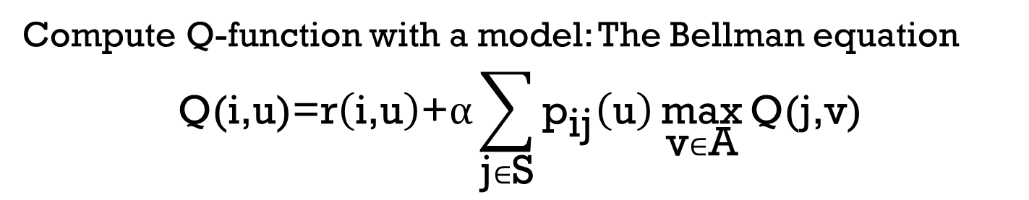

Reinforcement learning and dynamic programming
Compute Q-function with a model: The Bellman equation
$$\text{Q}\text{(}\text{i}\text{,}\text{u}\text{)=}\text{r}\left(\text{i}\text{,}\text{u}\right)\text{+}\text{α}\sum_{\text{j}∈\text{S}}{{\text{p}}_{\text{ij}}\left(\text{u}\right)\underset{\text{v}∈\text{A}}{\text{max}}{\text{Q}\text{(}\text{j}\text{,}\text{v}\text{)}}}$$
Agent
$$\underset{\text{v}}{\text{max}}{\text{Q}\left(1\text{,}\text{v}\right)}$$
$$\text{Q}\text{(}1\text{,}\text{u}\text{)}$$
0.5
Action
State
1
0.5
$$\underset{\text{v}}{\text{max}}{\text{Q}\left(2\text{,}\text{v}\right)}$$
u
1
2
3
$$\text{Q}\text{(}1\text{,}\text{u}\text{)=}\text{r}\left(1\text{,}\text{u}\right)\text{+}\text{α}\left(\text{0.5}\underset{\text{v}∈\text{A}}{\text{max}}{\text{Q}\left(1\text{,}\text{v}\right)\text{+0.5}\underset{\text{v}∈\text{A}}{\text{max}}{\text{Q}\text{(2,}\text{v}\text{)}}}\right)$$
Environment

Slide 12
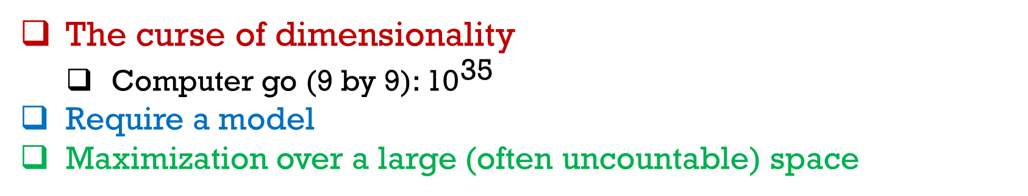

Reinforcement learning
The Bellman equation
$$\text{Q}\text{(}\text{i}\text{,}\text{u}\text{)=}\text{r}\left(\text{i}\text{,}\text{u}\right)\text{+}\text{α}\sum_{\text{j}\text{∈}\text{S}}{{\text{p}}_{\text{ij}}\left(\text{u}\right)\underset{\text{v}\text{∈}\text{A}}{\text{max}}{\text{Q}\text{(}\text{j}\text{,}\text{v}\text{)}}}$$
The curse of dimensionality
Computer go (9 by 9): ${\text{10}}^{\text{35}}$
Require a model
Maximization over a large (often uncountable) space

Slide 13
Topics to cover
Dynamic programming and the principle of optimality
Markov chains and Markov Decision Process (MDP)
Value iteration, policy iteration, and LP formulation
Q-Learning and SARSA
Temporal-difference learning
Linear and nonlinear function approximation
Deep RL based on Q-learning
Policy gradient algorithm and variance reduction
Deep RL based on policy gradient
Convergence analysis
Multi-armed bandit

Slide 14
Applications
https://gym.openai.com/envs

